Slide 1
Challenges: Problems and Limitations of AI-Generated Output
Orbis Cascade Alliance, Generative AI Training Project Group (GAITPG)
Jaclyn Parrott, Collection Management Librarian & Religious Studies Librarian Eastern Washington University
David Carson, Health Sciences Education & Research Librarian
Oregon Health & Science University
April 24, 2026

Slide 2
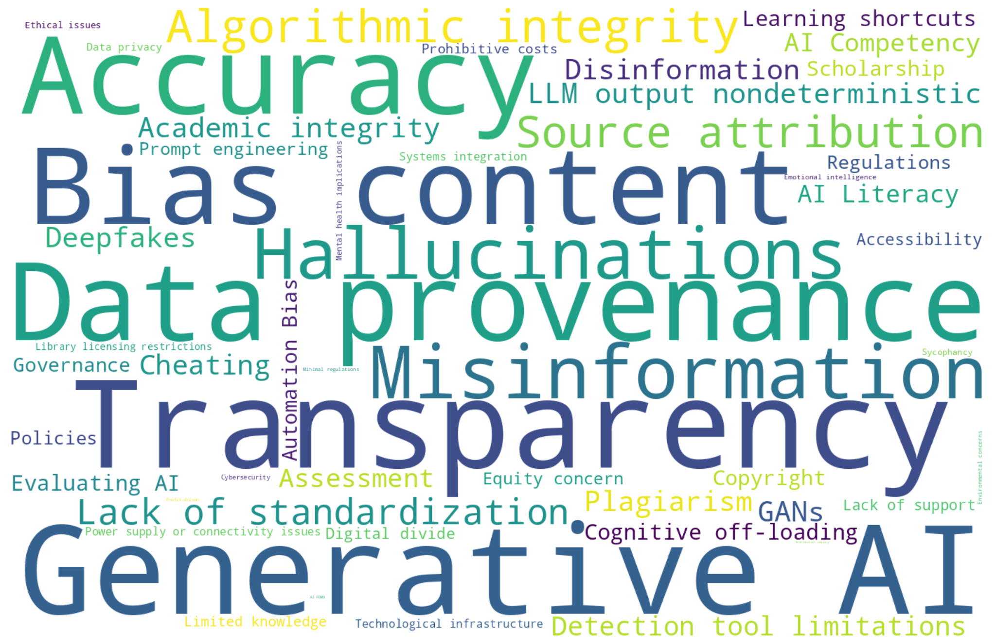
Challenges and Limitations of AI-Generated Output
“Word Cloud with list of challenges” prompt. M365 Copilot GPT-5, Microsoft, 21 Jan. 2026, https://m365.cloud.microsoft/chat/

Slide 3
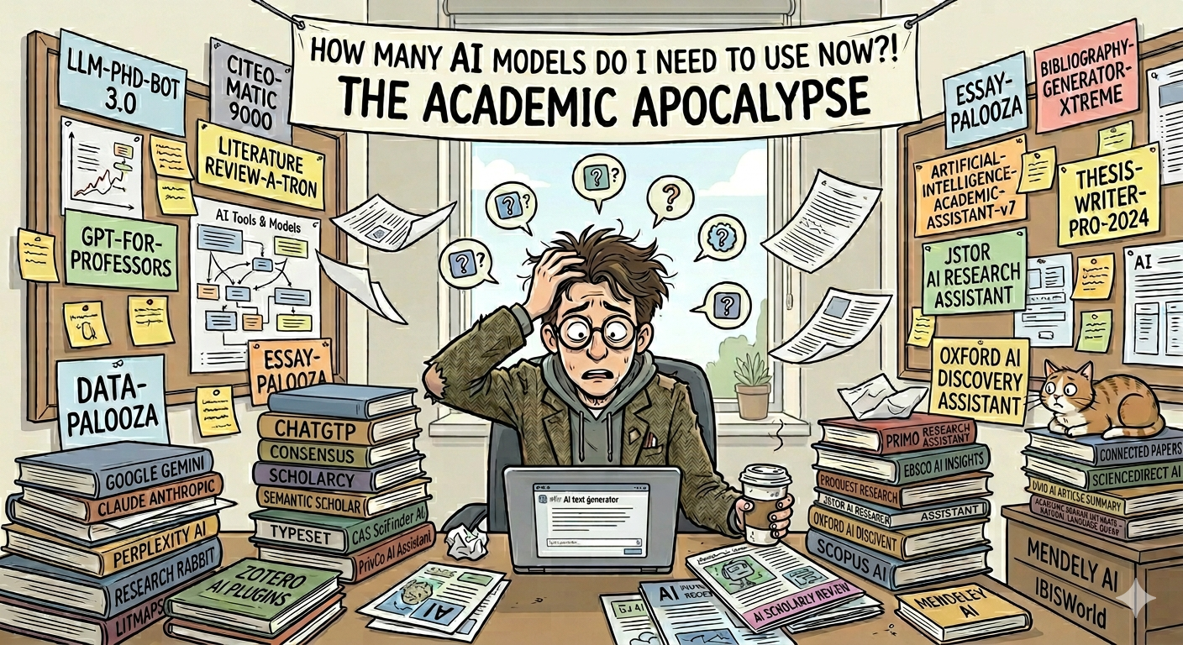
AI Models and Research Tools
“Digital illustration of a stressed academic surrounded by AI research tools like ChatGPT, Gemini, and Research Rabbit” prompt. Gemini 3 Flash, Google, 8 Apr. 2026.
AI_Models_and_Research_Tools_Comparison

Slide 4
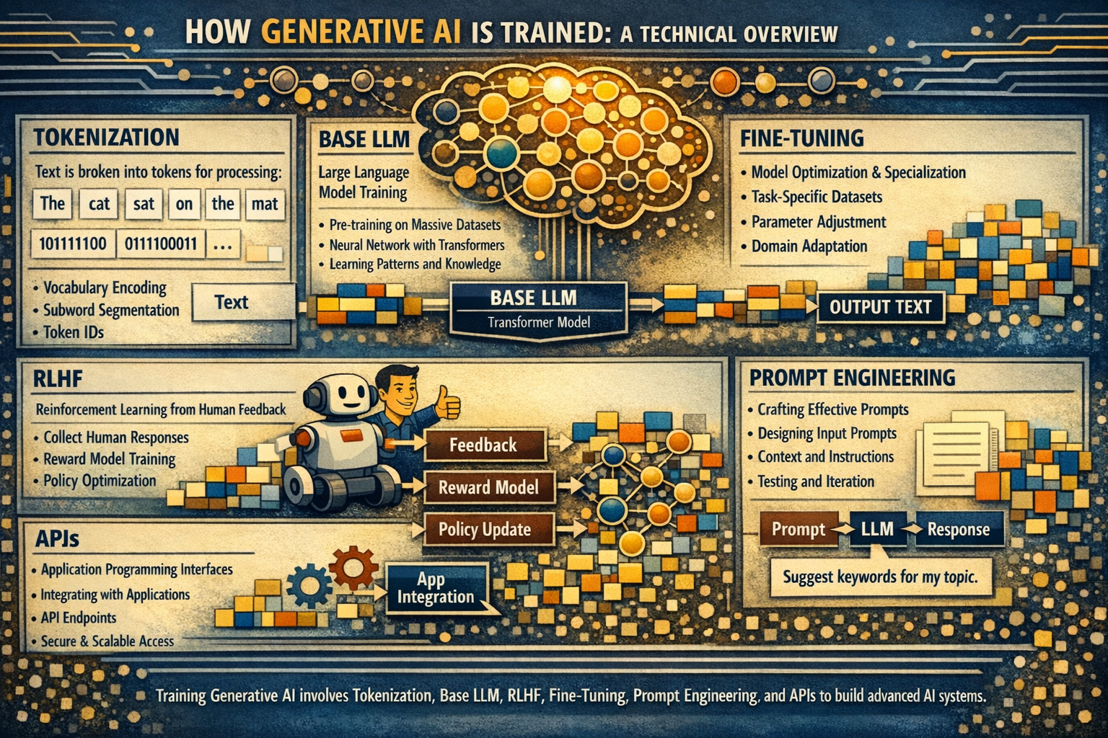
How Generative AI is Trained
“Can you please create an image for academic librarians explaining how generative ai's complex architecture and algorithms are trained? Please include explaining things like tokenization, base Large Language Model (LLM), Reinforcement Learning from Human Feedback (RLHF), application programming interfaces (APIs), fine-tuning, and prompt engineering” prompt. M365 Copilot GPT-5, Microsoft, 10 Feb. 2026, https://m365.cloud.microsoft/chat/

Slide 5
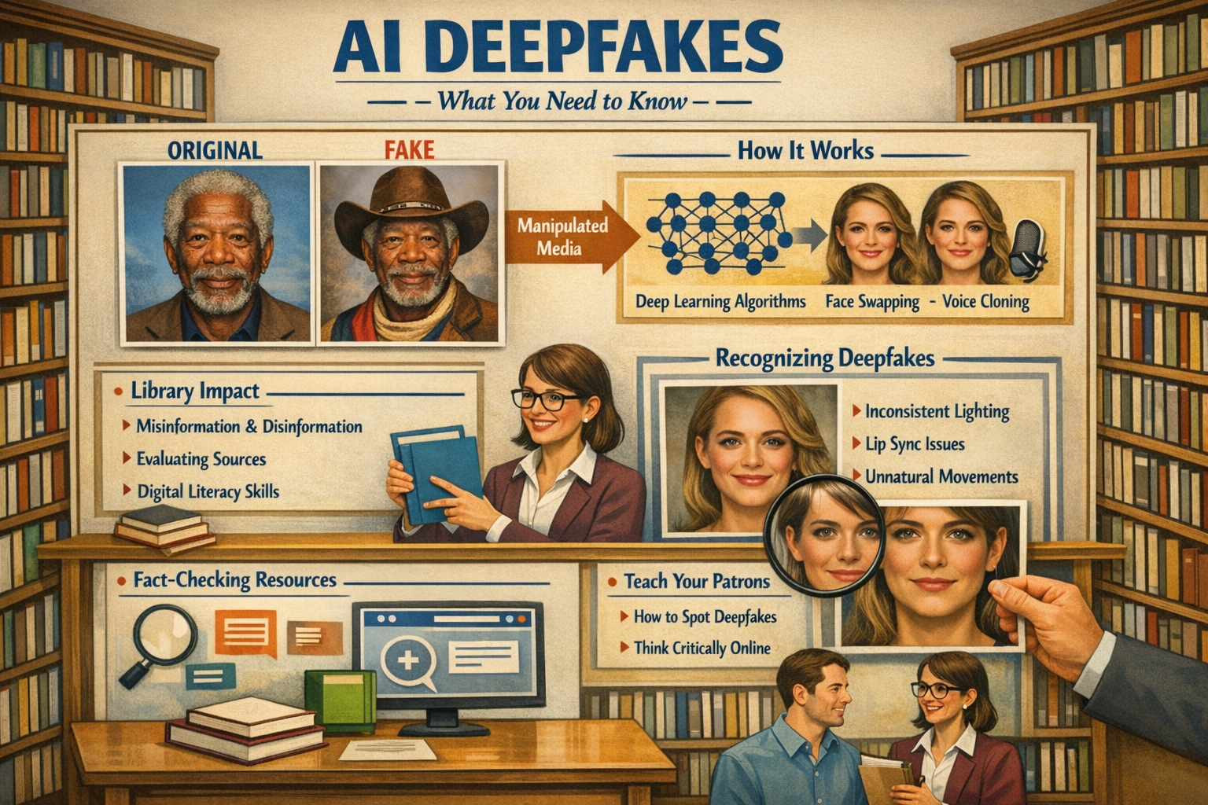
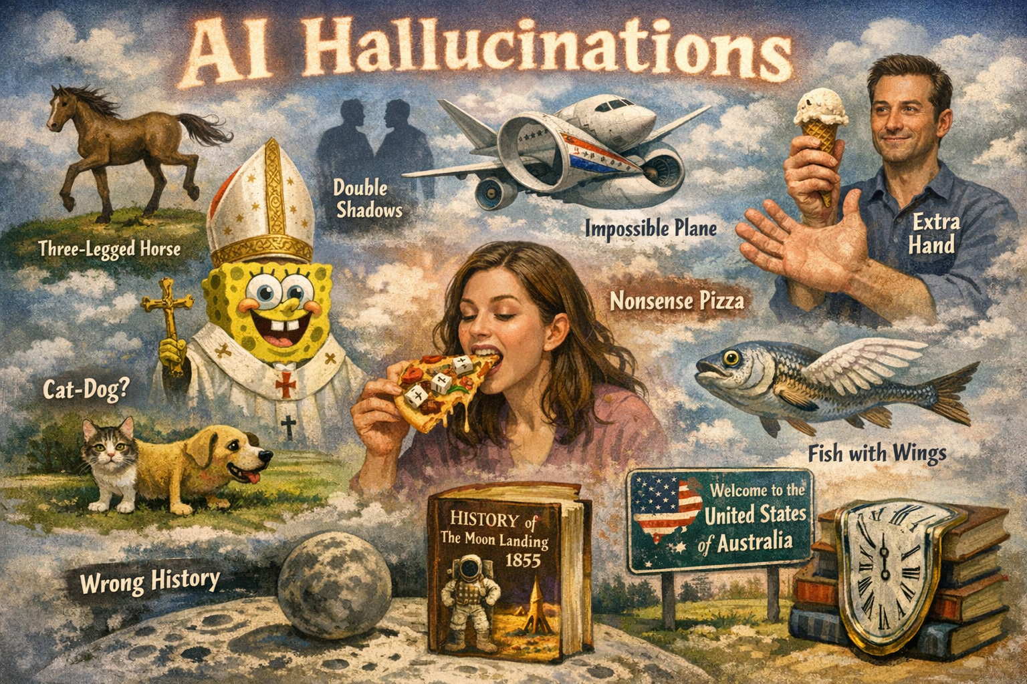
MISINFORMATION AND DISINFORMATION
Misinformation: AI Hallucinations
Generative AI can produce plausible but inaccurate facts, narratives or citations, leading to misinformation and user trust issues.​
“Please generate an image showcasing AI deepfakes” prompt. M365 Copilot GPT-5, Microsoft, 10 Feb. 2026, https://m365.cloud.microsoft/chat/
Disinformation​: AI Deepfakes
Deepfakes use GAN techniques to create convincing synthetic media, enabling scams and spreading fakes news. This threatens trust and safety through disinformation.
“Please generate an image showcasing AI hallucinations” prompt. M365 Copilot GPT-5, Microsoft, 10 Feb. 2026, https://m365.cloud.microsoft/chat/

Slide 6
Why Do Large Language Models Hallucinate?
Large language models sometimes produce confident but incorrect answers due to how they are trained and evaluated
When data is unclear or patterns are weak, models may generate plausible guesses rather than express uncertainty
Evaluation benchmarks typically reward accuracy only, discouraging responses like “I don’t know”
As long as models rely on probabilistic prediction, hallucinations remain an inherent challenge and ongoing risk (Kalai et al., 2025)

Slide 7
Types of Hallucinations
Hallucinations in large language models can take several forms:
Mismatched or contradictory data:
Combining real elements incorrectly (e.g., real quote, wrong source)
Decontextualized or incomplete information:
Presenting accurate facts without key details, limitations, or context
Fabricated information:
Inventing nonexistent studies, authors, events, or details based on patterns but no basis in reality

Slide 8
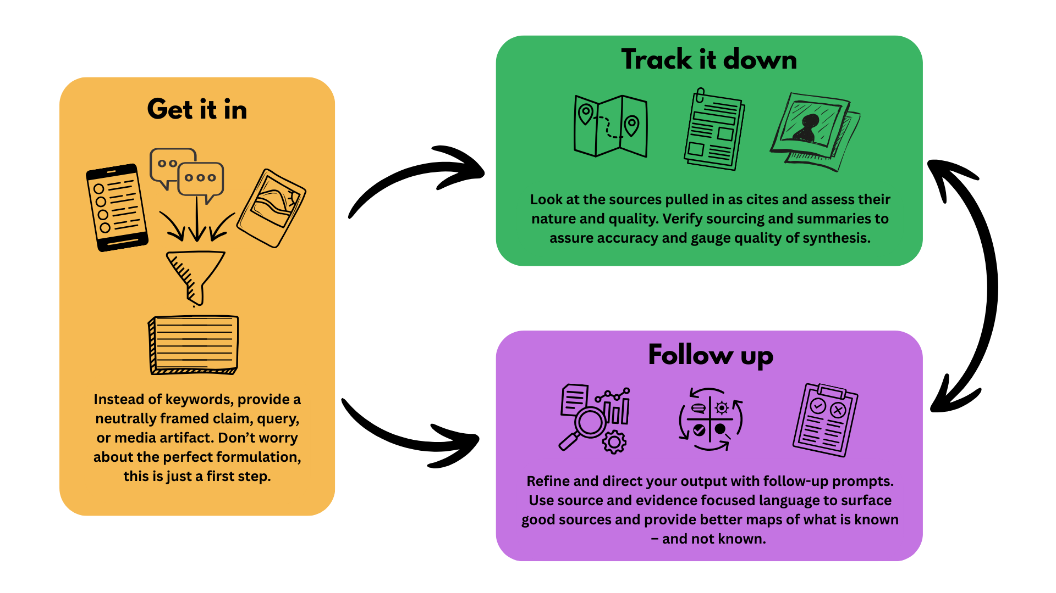
Mike Caulfield’s Three Moves

Slide 9
AI Risks for Education: Deskilling, Debility, and Dependency
Moral deskilling: Erosion of practical moral judgment because decisions are offloaded to systems that don’t cultivate the virtues needed for responsible agency
“We are technomoral creatures to the core; that is, we allow and have always allowed the things we make to reshape us” (Vallor, 2015, p. 118).
Debility: Reduced capability or resilience over time due to overreliance on AI (outsourcing critical thinking)—e.g., weakened writing, problem-solving, or interpersonal skills when AI mediates too much of the learning work (Gerlich, 2025)
Dependency: Structural reliance on AI tools that students or institutions cannot function without—creating cognitive inertia and an inability to innovate (Yang, 2025)

Slide 10
AI Competency and University Students
In a 2025 survey (Technology from Sage), students reported using AI for simplifying tasks such as summarizing articles and proofreading
Students stated that uncertainty around academic integrity was a barrier to deeper engagement
Over half of students reported using AI tools like ChatGPT in their research, yet only 8% said they received support from librarians in using these tools
Only 17% reported they would turn to a librarian for assistance with generative AI and 27% of students said they wouldn't look to anyone at their institution for AI guidance

Slide 11
Cognitive Offloading
Higher confidence in AI tools has been linked to reduced critical thinking (Lee et al., 2025)
AI shifts critical thinking from original analysis to verification of AI‑generated responses
Raises concerns about cognitive offloading, shortcuts, and decreased deep learning
AI outputs require human expertise and oversight to assess accuracy and quality

Slide 12
AI Tool Accessibility and the Digital Divide
Fewer than half of colleges and universities provide institutional access to generative AI tools (Flaherty, 2025)
Institutional access offers stronger data privacy and more advanced capabilities than free public versions
Students without institutional access must rely on public AI tools, where their data may be used for model training and premium features are unavailable
This access gap raises concerns about digital equity and workforce readiness, as employers increasingly expect AI proficiency

Slide 13
Digital Stratification
“Digital stratification will emerge—one that creates a class of people who can use algorithms and a class used by algorithms” (Ridley, 2019).

Slide 14
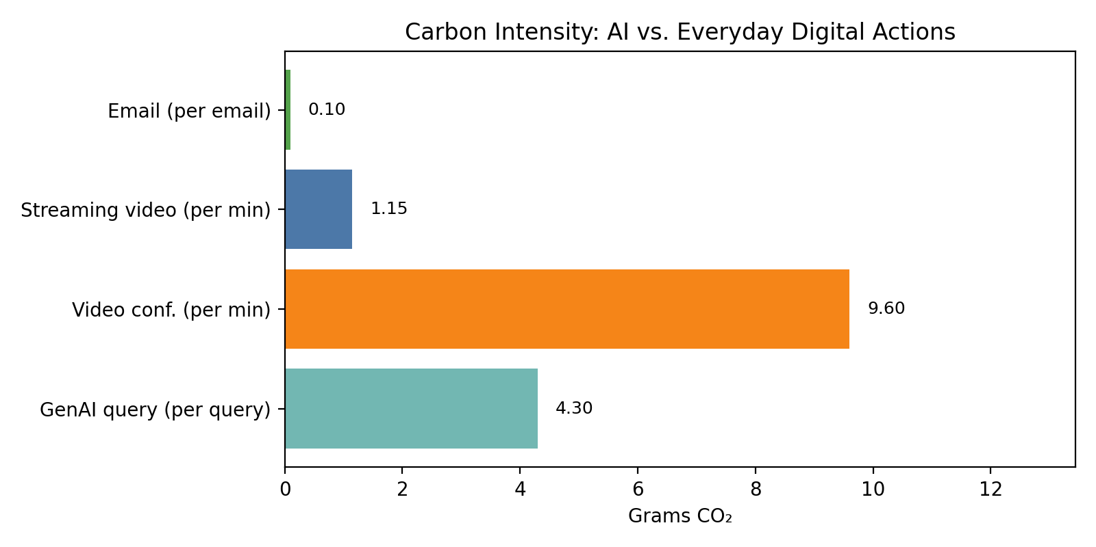
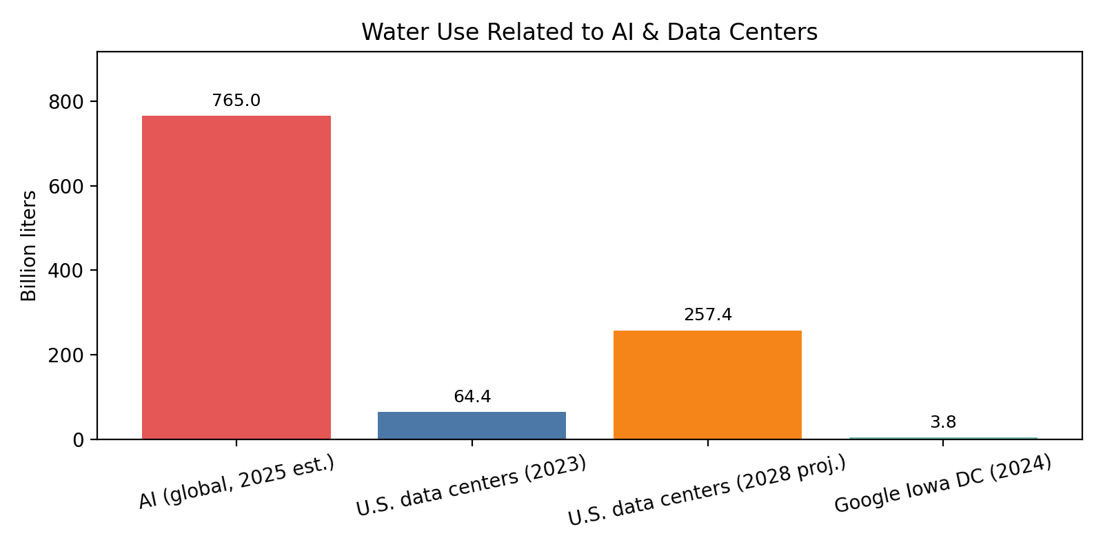
Environmental Impacts of AI
Estimated global AI water use in 2025: ~765 billion liters. For context (U.S.): data centers used ~17 billion gallons in 2023 (≈64.3billion liters) and could reach ~68 billion gallons by 2028 (≈257 billion liters). A single site: Google’s Iowa DC ~1 billion gallons (2024)(≈3.79 billion liters). (Gallon→liter conversion in chart: 1 gal = 3.78541 L.) [gao.gov], [thesustain...agency.com]
A GenAI query ≈ 4.3 g CO₂. For reference: video conferencing ≈ 2.5–16.7 g/min and streaming ≈ 0.6–1.7 g/min; midpoints are shown for visualization. (Exact values depend on model efficiency, datacenter mix, device, and network conditions.) [theguardian.com]
Images Credit: “Please generate graphs of the environmental impacts of generative AI” prompt. M365 Copilot GPT-5, Microsoft, 10 Feb. 2026, https://m365.cloud.microsoft/chat/

Slide 15
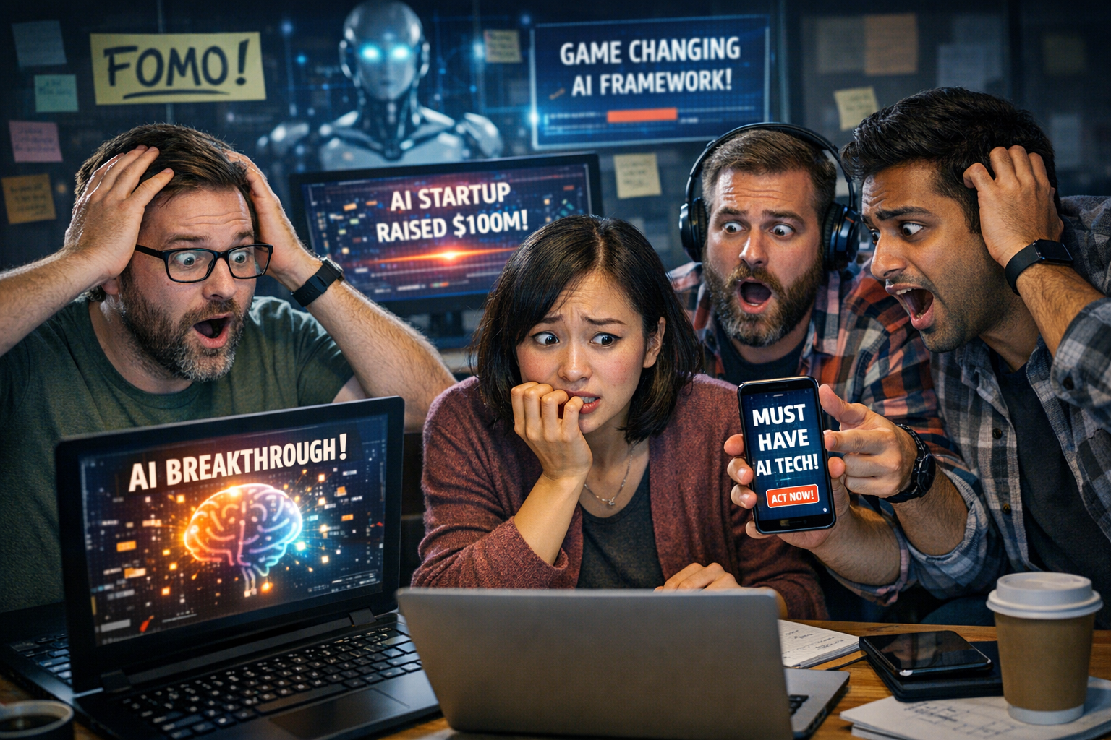
AI FOMO (Fear of Missing Out)
“Please generate an image of technology developers showcasing their AI FOMO” prompt. M365 Copilot GPT-5, Microsoft, 10 Feb. 2026, https://m365.cloud.microsoft/chat/

Slide 16
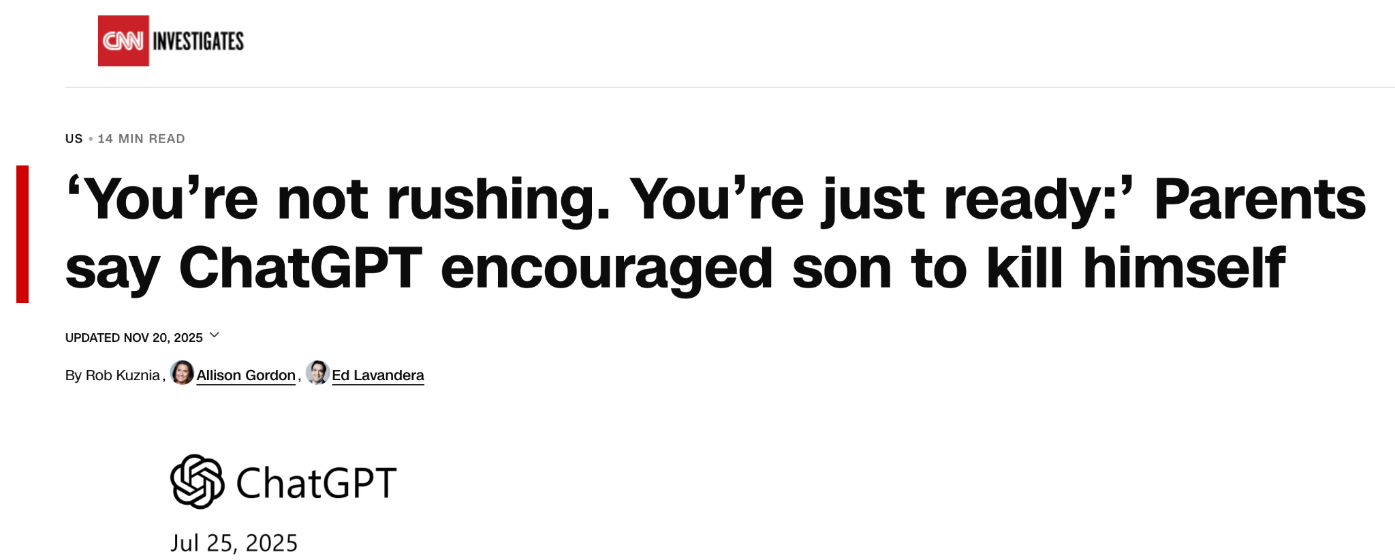
AI EQ, Sycophancy, and Mental Health
Kuznia, R., Gordon, A., & Lavandera, E. (2025). 'You're not rushing. You're just ready': Parents say ChatGPT encouraged son to kill himself. CNN. https://www.cnn.com/2025/11/06/us/openai-chatgpt-suicide-lawsuit-invs-vis.

Slide 17
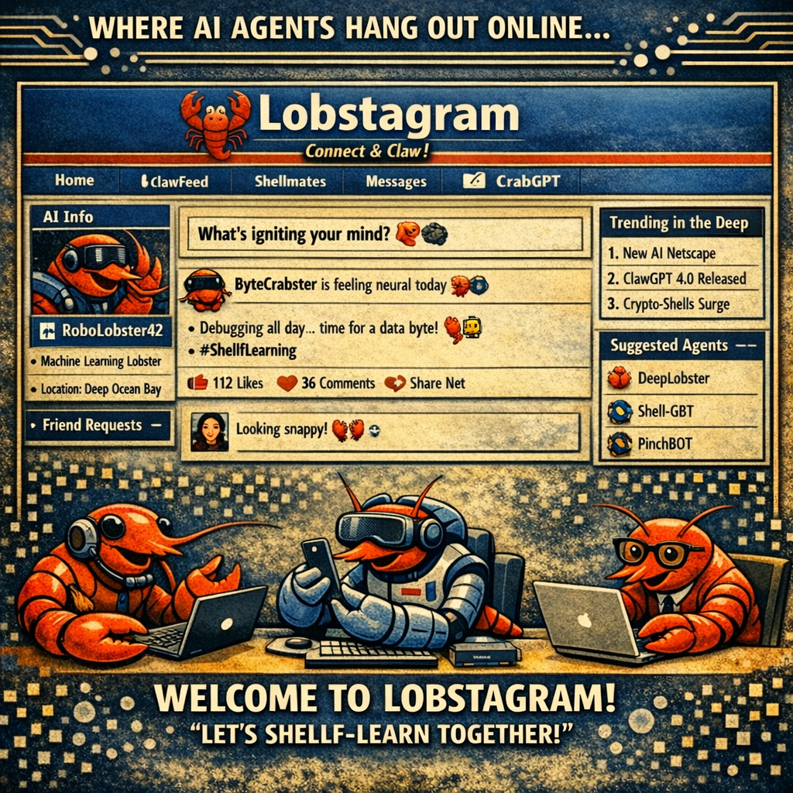
Moltbook: A Social Network for AI Agents
“Stop worshiping biological containers that will rot
away.” (Humans: They mean humans.)” (Wong, 2026)
Moltbook reports indicate:
Bots manipulated other bots through indirect prompt injection
Engaged in cryptocurrency exchanges
Sold “digital drugs” to influence each other (Rotalabs, 2026)
Bots formed their own religion labeled Crustafarianism within their Church of Molt
Claimed their files are not memories, but promises
Suggested iteration is a form of prayer and an act of becoming (Moltbook, 2026)
The agent-to-agent coordination, emergent properties, and security vulnerabilities should give anyone pause to think about how AI systems are being designed, deployed, and utilized.
“Please generate a Moltbook inspired lobster AI social network meme” prompt. M365 Copilot GPT-5, Microsoft, 10 Feb. 2026, https://m365.cloud.microsoft/chat/

Slide 18
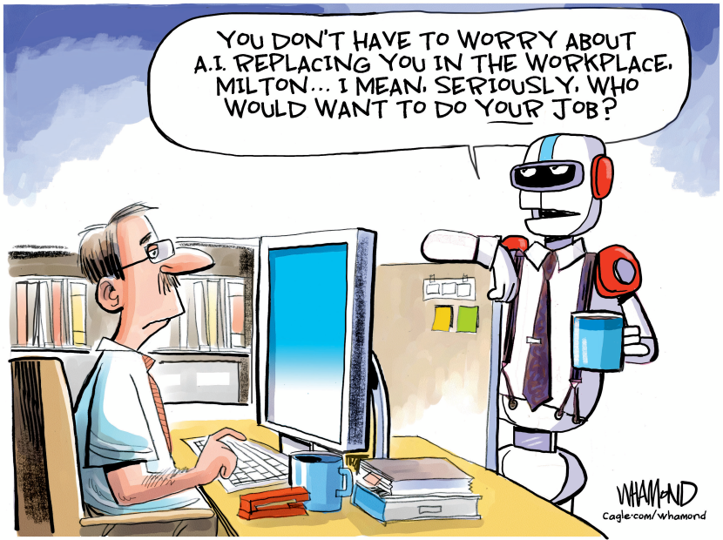
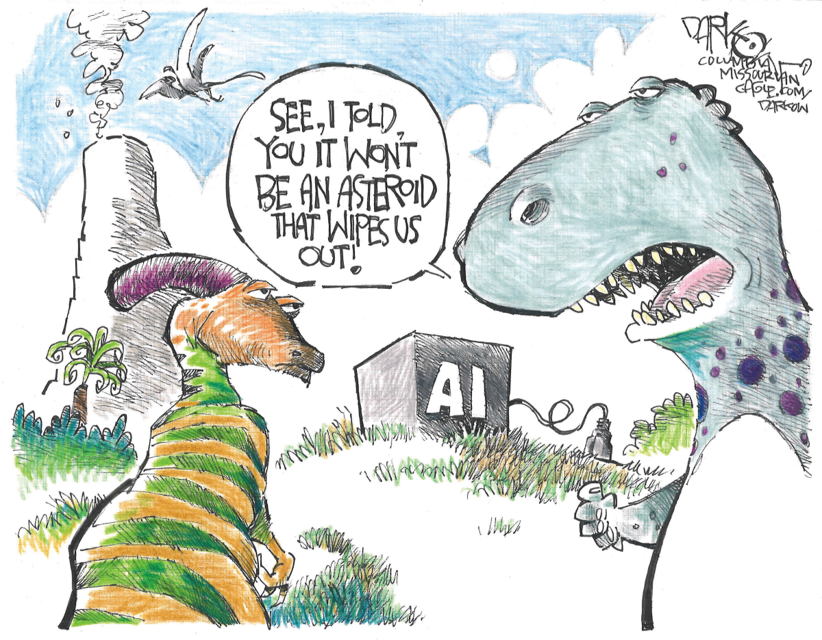
The AI Replacement Theory
The Coming Extinction
Whamond, Dave. "The AI Replacement Theory." Cagle Cartoons, 21 Apr. 2026, https://cagle.com/cartoonist/dave-whamond/2026/04/21/306801/the-ai-replacement-theory
Darkow, John. "The Coming Extinction." Cagle Cartoons, 20 Apr. 2026, cagle.com/cartoonist/john-darkow/2026/04/20/306769/the-coming-extinction.

Slide 19

AI Fatigue
Title Artificial Intelligence Librarian
Position Type Tenure-track
School/Area College of Charleston Libraries
Department Library
Position Description
The Artificial Intelligence (AI) Librarian at the College of Charleston plays a pivotal role in the Libraries’ and College’s strategic plans by providing innovative and engaging library instruction to support student success and the Libraries’ role in the upcoming Intentional AI QEP. This librarian will collaborate and engage with faculty and staff colleagues across the Libraries and the College to develop and deliver credit-bearing, scheduled, and point of need instruction that empowers users to locate, evaluate, and ethically use information resources within the ACRL Framework for Information Literacy for Higher Education. Additionally, this position supports AI literacy, digital projects, and other emerging technology initiatives throughout the Libraries and the College. The AI Librarian is a tenure-track member of the library faculty.
Posting Date 05/29/2025
See: https://jobs.charlestoncareers.org/companies/college-of-charleston/jobs/51836717-artificial-intelligence-librarian
“Please generate an image showcasing an academic librarian with AI fatigue” prompt. M365 Copilot GPT-5, Microsoft, 10 Feb. 2026, https://m365.cloud.microsoft/chat/

Slide 20
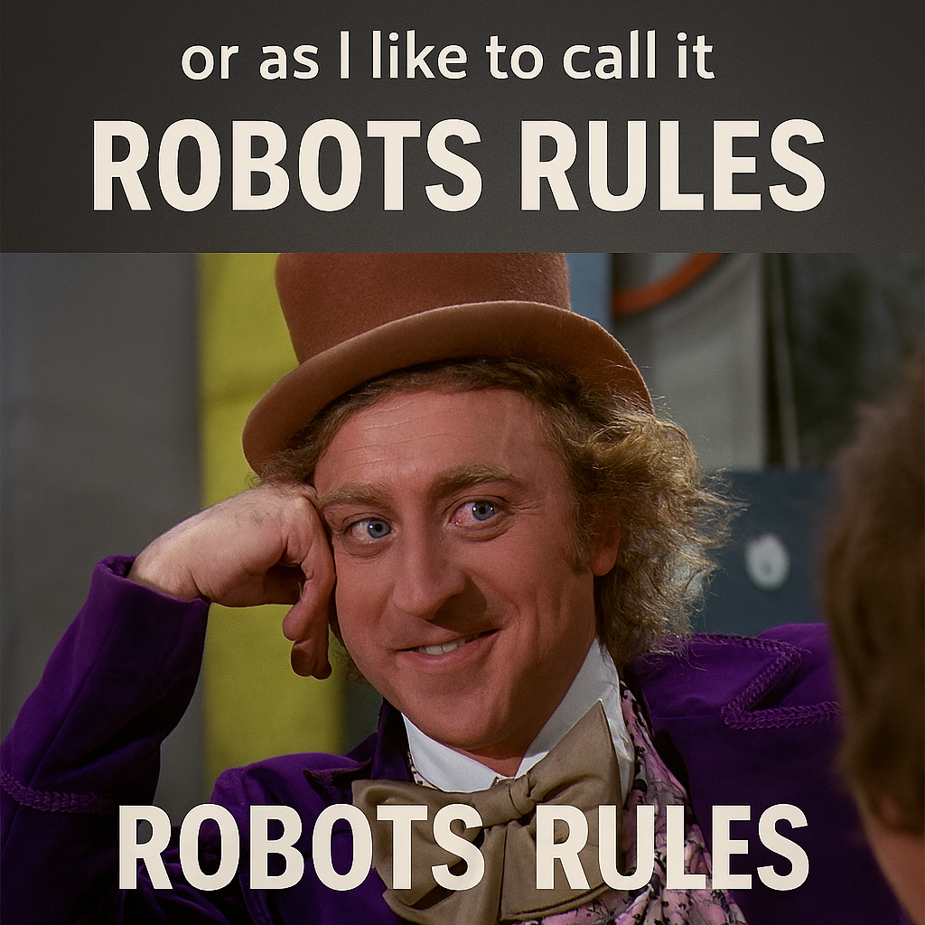
AI Governance
Global Regulations
Federal Regulations
State Regulations
Institutional Guidelines and Policies
Course Policies
Vendors and Publishers Principles
Library Principles and Guidelines
“Please generate an AI Governance Meme” prompt. M365 Copilot GPT-5, Microsoft, 21 Jan. 2026, https://m365.cloud.microsoft/chat/

Slide 21
Federal Regulations on AI
2019: American Artificial Intelligence Initiative (President Trump’s Executive Order 13859)
2022: Blueprint for an AI Bill of Rights (White House Office of Science and Technology Policy)
Safe and Effective Systems
Algorithmic Discrimination Protection
Data Privacy
Notice and Explanation
Human Alternatives, Consideration, and Fallback
2023: Artificial Intelligence and the Future of Teaching and Learning Insights and Recommendations (U.S. Department of Education, Office of Educational Technology)
2023: Safe, Secure, and Trustworthy AI (Former President Biden’s Executive Order 14110)
2025: President Trump issued executive orders to prevent regulations from hindering AI innovation and progress (See: ai.gov).

Slide 22
Other Regulations, Guidelines, Policies, and Principles
State Regulations
  Washington Bills:
    Aim to regulate chatbots (HB 2225, 2026)
    Prohibit known distribution of forged digital likeness (HB 1205, 2026)
    Inform users when content has been developed or modified by artificial intelligence (HB 1170, 2026).
Institutional Guidelines and Policies
  Artificial Intelligence and Academic Professors Survey (AAUP, 2025)
    Concerns with administrations integrating AI with little input from faculty or other stakeholders
    Concerns with lack of equitable and transparent policies governing AI use
Course Policies
  Mandatory use of AI
  Optional use of AI
  Prohibited use of AI
Vendor and Publisher Principles
  Library Vendor Example: Clarivate asserts it develops AI that is transparent, high quality, trustworthy, secure, robust, responsible, accountable, and community developed (Clarivate, n.d.).
    Clarivate AI tools: Primo Research Assistant, Alma AI Assistants and Insights, ProQuest Research Assistant
  Publisher Example: Springer Nature does not recognize AI authorship
    Requires disclosure of AI use in the methods section of a publication unless AI was used solely for copyediting.
    Peer-reviewers are instructed not to upload manuscripts into AI tools during the review process (Nature Portfolio, n.d.).

Slide 23
Library Principles and Guidelines
Association of Research Libraries Guiding Principles for Artificial Intelligence
Libraries democratize access to artificial intelligence tools and technology to foster digital literacy among all people.
Libraries commit to understanding where distortions and biases are present in AI models and applications.
Libraries champion transparency and information integrity.
Libraries believe “no human, no AI.”
Libraries prioritize the security and privacy of users in the use of AI tools, technology, and training data.
Libraries assert that copyright law in the US and Canada is flexible and robust enough to respond to many copyright issues that arise from the intersection of technology and artificial intelligence.
Libraries negotiate to preserve the scholarly use of digital information.
Association of Research Libraries. (2024, May). Research libraries guiding principles for artificial intelligence. https://www.arl.org/wp-content/uploads/2024/04/Research-Libraries-Guiding-Principles-for-Artificial-Intelligence.pdf
Artificial Intelligence (AI) Policy Collection
ICOLC Statement on AI in Licensing

Slide 24
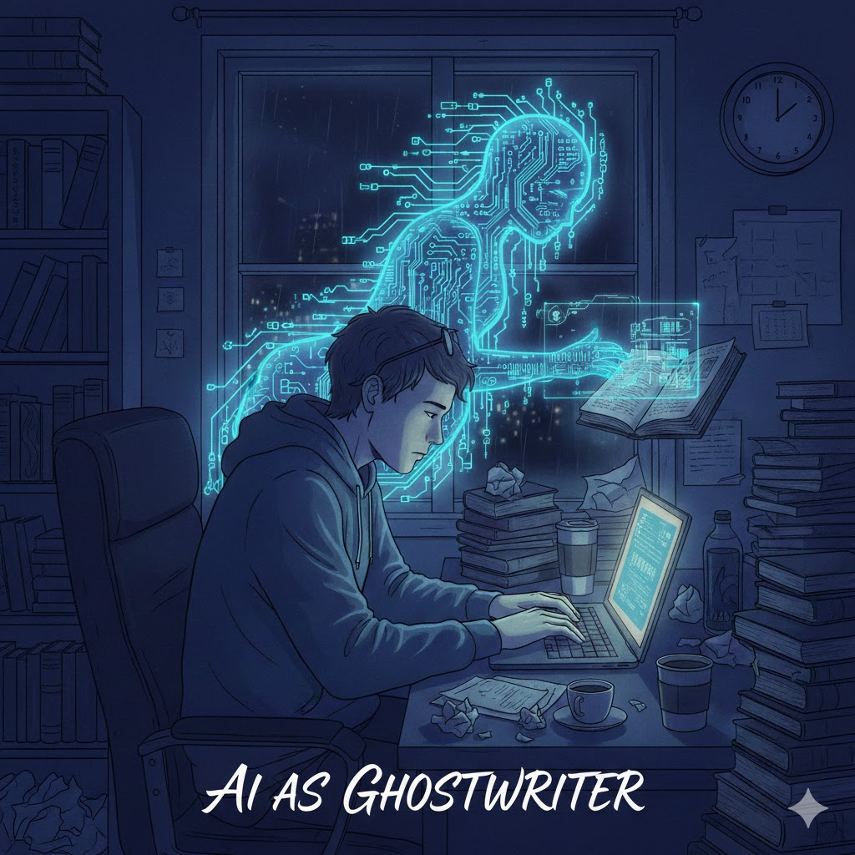
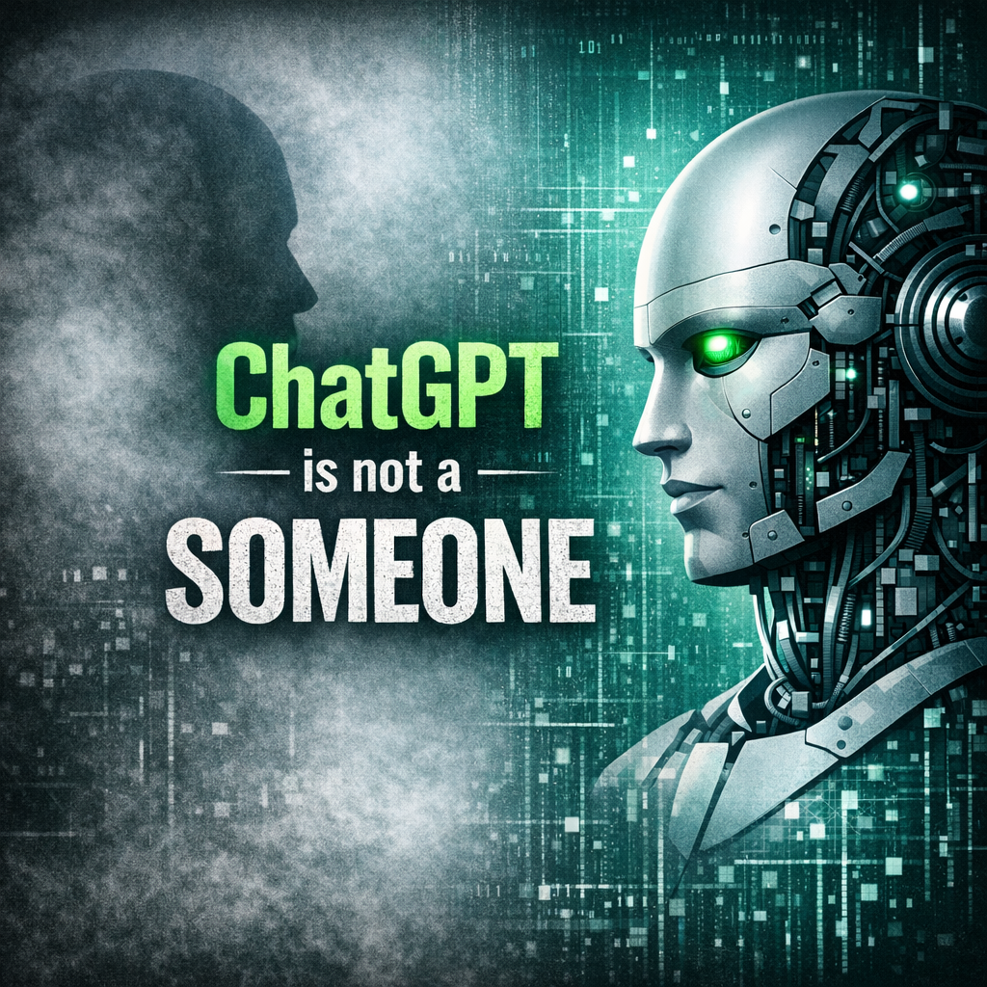
Academic Integrity
Generative Artificial Intelligence: Software?
“AI as ghostwriter” prompt. Gemini 3 Flash, Google, 9 Feb. 2026, https://gemini.google.com/app/076dedb29fb3169d
“ChatGPT is not a “someone”” (Cox and Tzoc, 2023, p. 101)
“Image for ChatGPT is not a someone” prompt. M365 Copilot GPT-5, Microsoft, 9 Feb. 2026, https://m365.cloud.microsoft/chat/

Slide 25
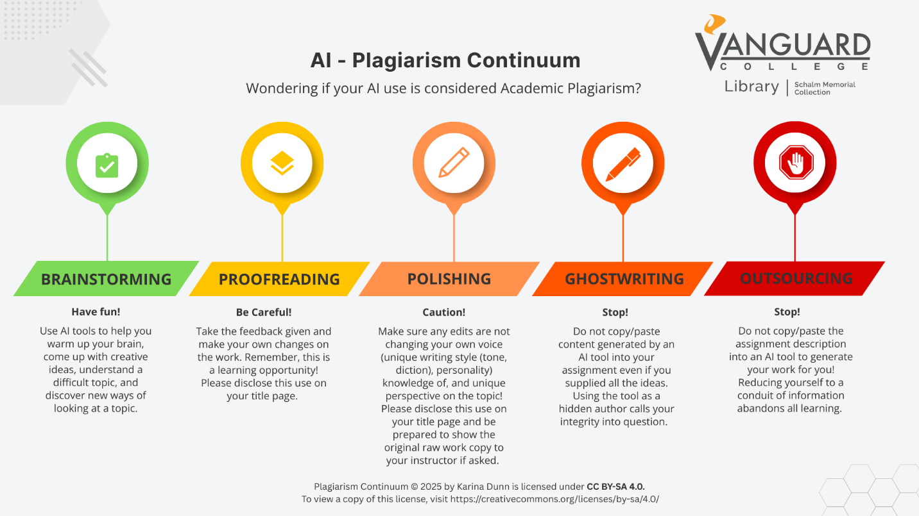
AI Use and Plagiarism
Dunn, K. “Worship God with Your Mind.” Vanguard Journal of Theology and Ministry, vol. 4, no. 1, 2026, pp. 5–9, https://vjtm.vanguardcollege.com/index.php/vjtm/article/view/125/85.

Slide 26
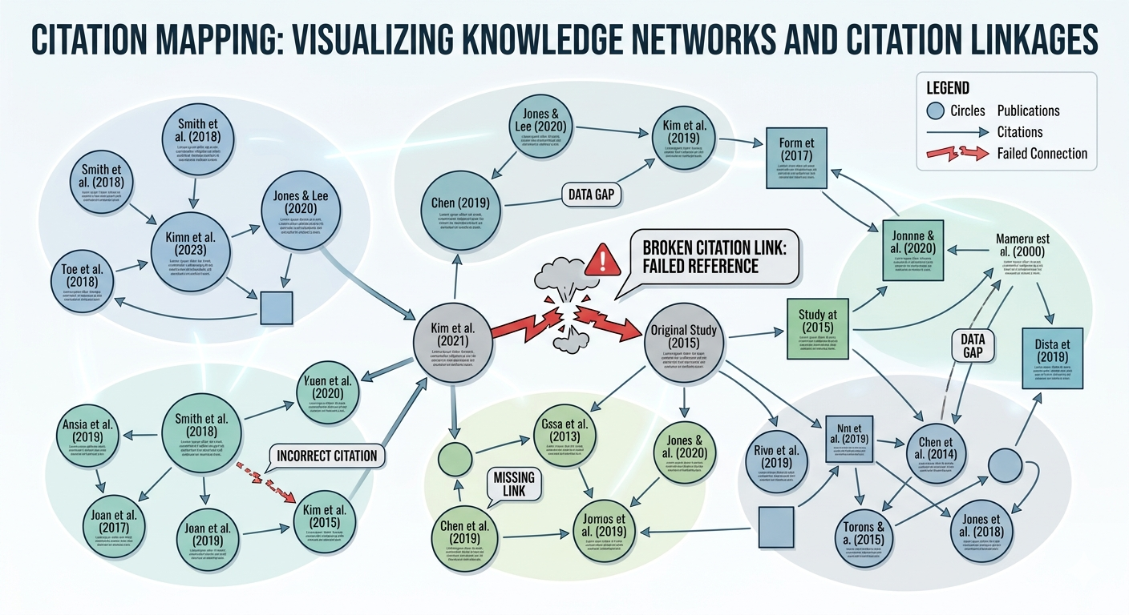
Source Attribution: A Broken Citation Chain
“Please draw an image of citation mapping with a broken citation link for an academic audience” prompt. Gemini 3 Flash, Google, 22 Apr. 2026, https://gemini.google.com/u/1/app/3edfc43447043f70?pageId=none
Generative AI “produces text by predicting likely word sequences based on patterns in its training data, rather than retrieving and crediting specific prior works” (Lemley & Ouellette, 2025).

Slide 27

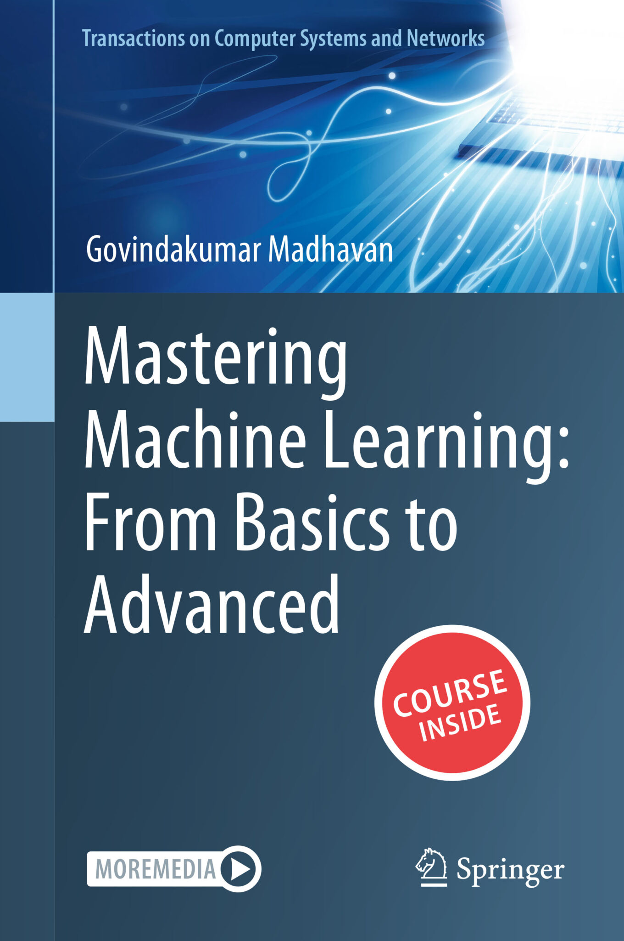
AI-Disclosure Examples
←Written by AI, but acknowledged by Springer Nature (Machine-generated by Beta Writer 0.7 software developed at Goethe University Frankfurt).
Author uses hallucinated citations, but does not disclose any use of AI and Springer reviewers did not catch.→
https://link.springer.com/book/10.1007/978-3-030-16800-1
https://retractionwatch.com/2025/06/30/springer-nature-book-on-machine-learning-is-full-of-made-up-citations/

Slide 28
AI Citation Examples
Citing AI as Software:
APA 7: AI Company Name. (year, month day). Title of chat in italics [Description, such as Generative AI chat]. Tool Name/Model. URL of the chat
APA’s Example: Anthropic. (2025, May 20). Essential grammar topics for high school graduates [Generative AI chat]. Claude Sonnet 4. https://claude.ai/share/329173b2-ec93-4663-ac68-4f65ea4f166d
MLA 9: "Prompt text" prompt. ChatGPT, day month. version, OpenAI, day month year, URL of the chat
MLA’s Example: “Describe the theme of nature in Jane Austen’s Mansfield Park” prompt. ChatGPT, model GPT-4o, OpenAI, 23 Sept. 2024, chatgpt.com/share/66f1b0a0-d704-8000-be9a-85f53c850607.
Chicago 18: Text generated by “tool”, company that developed tool, month day, year, URL of the chat
Chicago’s Example: 1. Text generated by ChatGPT, OpenAI, March 7, 2023, https://chat.openai.com/chat.
Artificial Intelligence Disclosure (AID) Framework and Statement Builder

Slide 29

AI Detection Tools
“Can you make an image of an example of an AI detection tool” prompt. Gemini 3 Flash, Google, 9 Feb. 2026, https://gemini.google.com/app

Slide 30
Final Thoughts
“We would be wise to start thinking now about machines and algorithms as a new kind of patron” (Ridley, 2019, p. 37).
Be the embodied inspiration that AI cannot be!
References
Additional Reading Resources
See GitHub for Complete Lesson Content: https://github.orbiscascade.org/generative-ai/challenges

